Slide 1


SocialBuzz

Slide 2


Today's agenda
Project recap
Problem
The Analytics team
Process
Insights
Summary

Slide 3

Creation of an up-to-date big data best practices presentation
Extraction of sample data sets using SQL
Merging of sample data set tables
Analysis of sample data sets with visualizations
Full documentation of the process that we can guide them through for IPO
Project Recap

Slide 4


Problem
Highlights top 5 categories with the more popularity

Slide 5



The Analytics team
Andrew Fleming
(Chief Technical Architect)
Marcus Rompton
(Senior Principle)
Snehal Karmuse
(Data Analyst)

Slide 6
Process
1
Understand Data
Understand Dataset and Data Modeling
2
Data Cleaning
3
Data Visualization
4
5
Conclusion or Documentation

Slide 7

Insights
Get the score for each category and find top 5 popular category.
Popular category by month
Popular category by age
Reaction for each category (if reaction type is disgusting remove or change content.)
Number of users on SocialBuzz

Slide 8
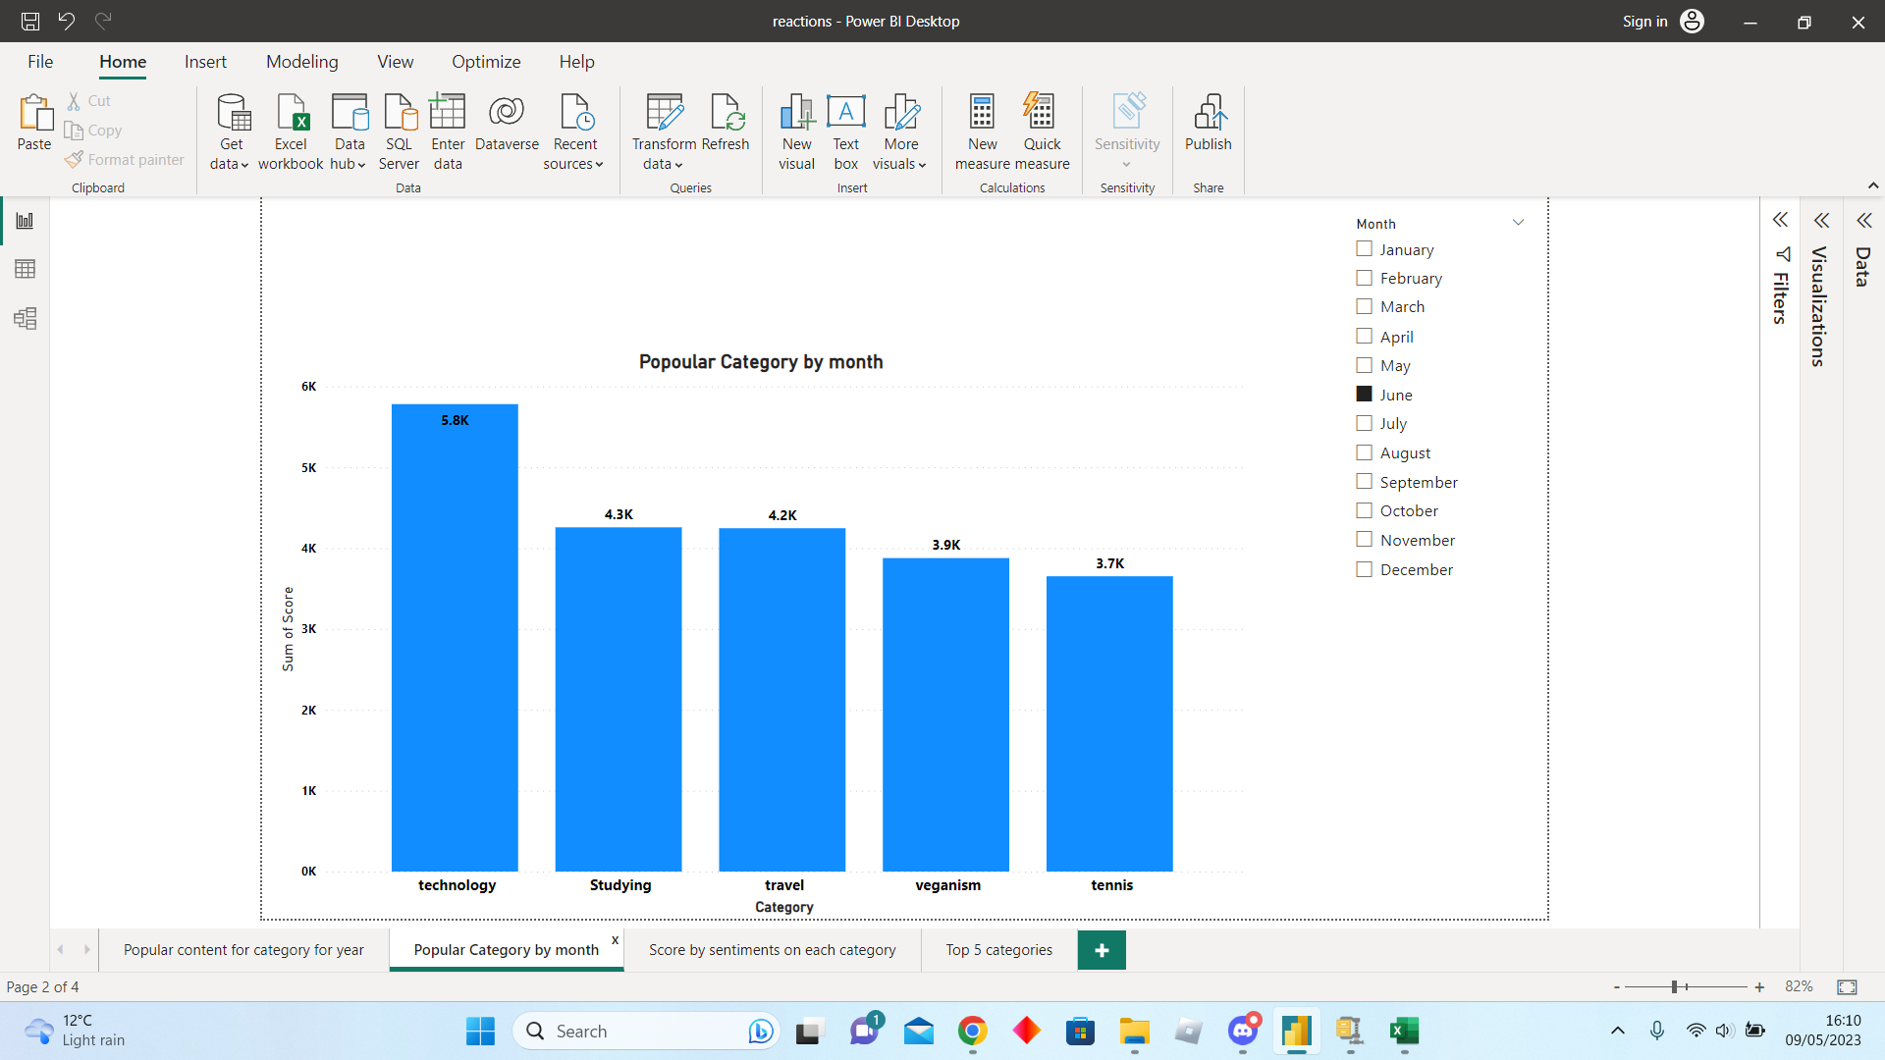
Popular Category by Month

Slide 9
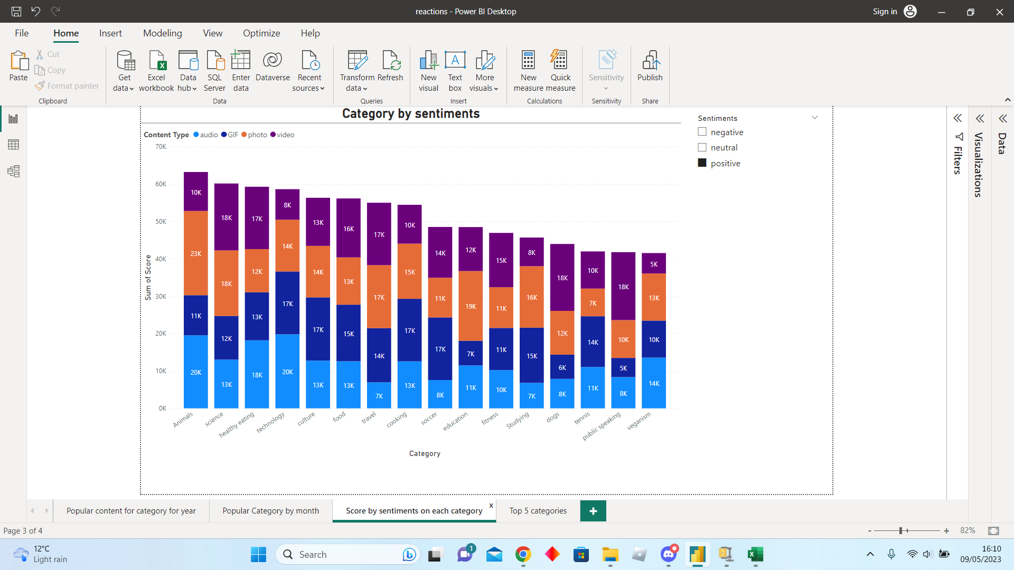
Category by sentiments

Slide 10
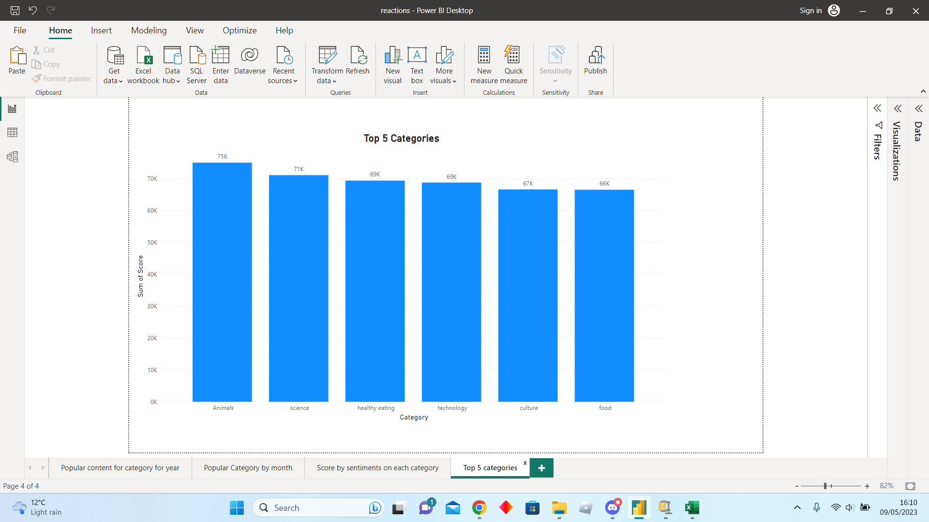
Top 5 categories

Slide 11
Agenda
Add company background what company is
Tasks given by company
Explain problem with statestic
Info about team
Process or steps to follow to come for conclusion
Insight for sub ex one(no of categories, posts, monthly post etc.)
Answer the question visualization ( explain rest of the categories and tell them about factual things like tech or science is popular as well.)
Popularity percentage of each top 5 categories(explain to think to expand other categories)
Summarization( analysis of data, insight, next step what we can do for you)

Slide 12
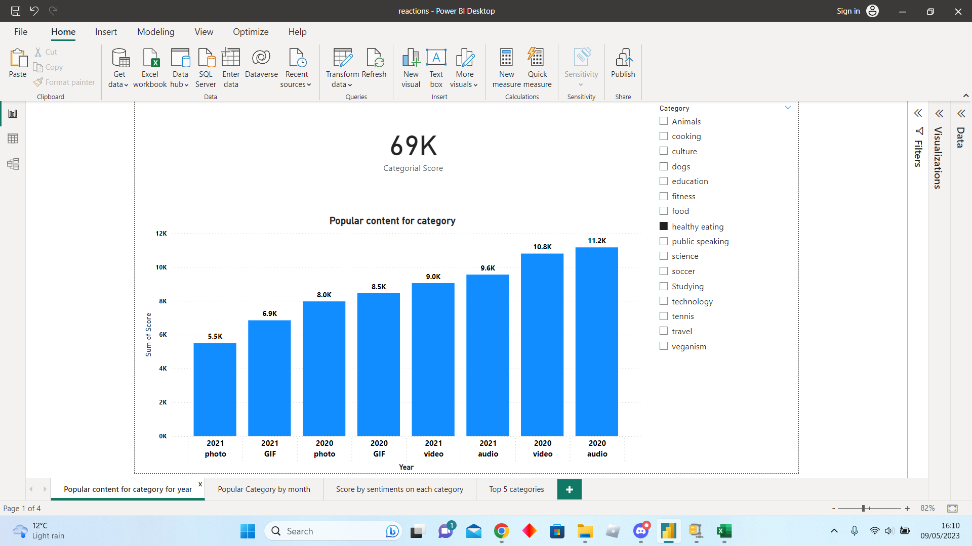
Popular Content by Category

Slide 13
I have presented 4 graphs which shows
Top 5 Categories,
Category by sentiments and content type (where we can easily see what content type is user use most)
Popular category per year
Popular category by month
(where we can dig down and find out any specific time of the year or month when user is accessing content.
Summary

Slide 14

Thank you!
ANY QUESTIONS?

